Slide 1
Selenium Automation Test Framework V1 –21Mar2021

Slide 2
Selenium Automation Test Framework V2 –25Mar2021
Jenkins
Start Test
Selenium Grid
Choose Machine
Daily Smoke Test
SetUp
Read-Properties
Read-TestData
Daily Regression Test
Start Test Reporting
Git
Sprint Regression Test
Mvn
Manual TestData Prep
Test Preparation - pom
Testng
Auto TestData Prep
Cucumeber
Test Execution
Rest-Assured/Selenium
Write-TestData
Tear Down
End Test Reporting

Slide 3
Test execution in parallel Mode
Parallel mode is on ‘feature’ level.
Each feature talks about an user story.
Each java runner class mapped to a feature file.
TestNg invokes execution in parallel mode on class level.

Slide 4
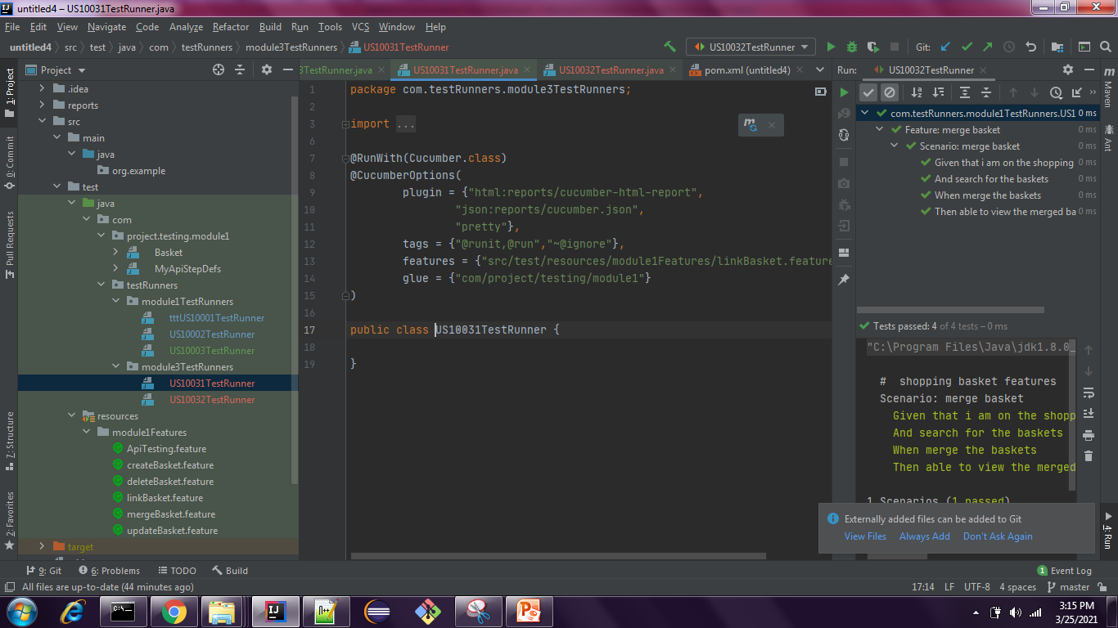

Slide 5
